Slide 1




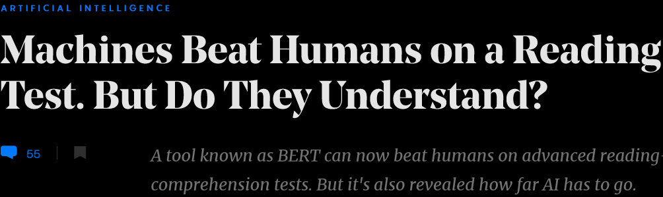



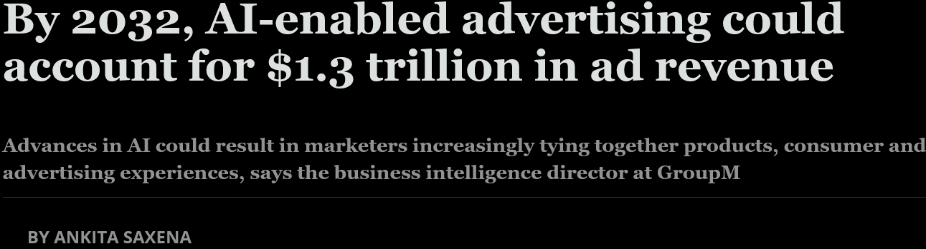


science.org
forbes.com
quantamagazine.org
cnbc.com
HELLO
my name is
MELBO
forbesindia.com
linkedin.com

Slide 2
getting started
can ML predict the questions that will come in the test next week ?? … just asking for a friend …

Slide 3
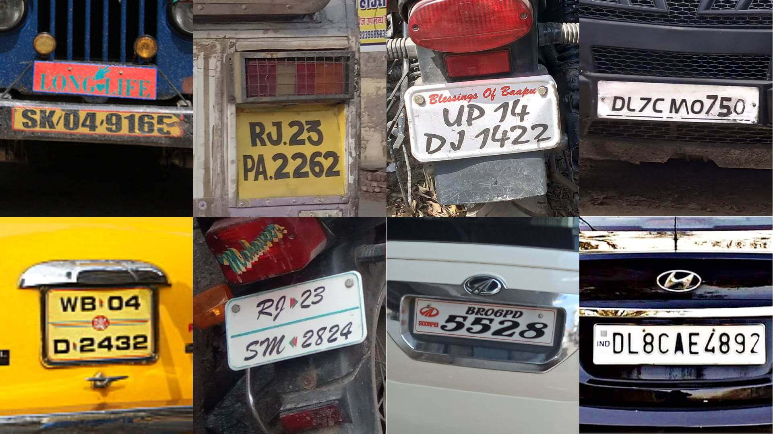
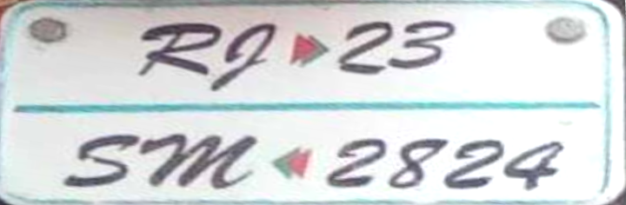
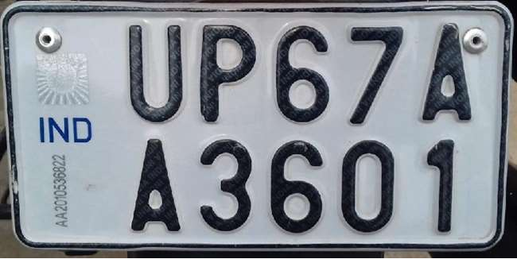
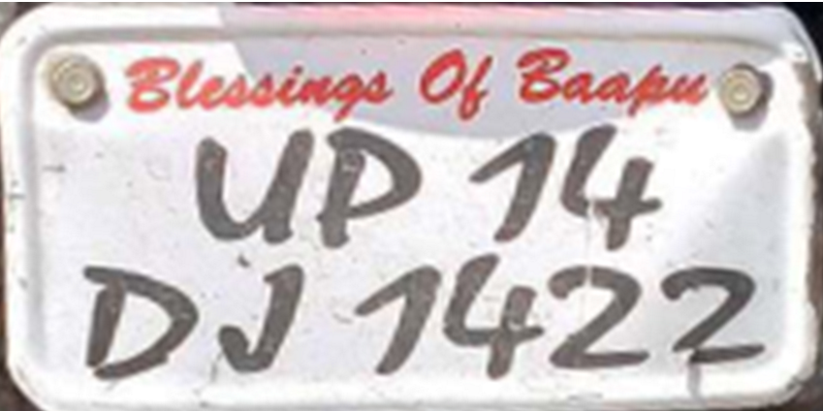
What is Machine Learning?
“
“
The art and science of solving ill-understood tasks
RJ23PA2262 → Rajasthan
RJ23SM2824 → Rajasthan
UP14DJ1422 → Uttar Pradesh
UP67AA3601→ Uttar Pradesh
DL7CM0750 → Delhi
DL8CAE4892 → Delhi
AP | Andhra Pradesh
BR | Bihar
DL | Delhi
GA | Goa
KA | Karnataka
MH | Maharashtra
RJ | Rajasthan
UP | Uttar Pradesh
A WELL-UNDERSTOOD TASK
AN ILL-UNDERSTOOD TASK

Slide 4







What is Machine Learning?
নমস্কার
“
“
The art and science of solving ill-understood tasks
It is kind of a big deal. Remember, we want to write code to do this
R
D
L
C
Are you sure even humans would be able to do this for scripts they don’t know?
U
P
J
Big deal! humans can do this just fine!

Slide 5









What is Machine Learning?
“
“
The art and science of solving ill-understood tasks
Sorting: given $n$ numbers, sort them in decreasing order of their value
Recommendation: given $n$ items, for each user, sort the items in decreasing order of how much the user likes them
INPUT
OUTPUT
INPUT
OUTPUT
4
9
5
5
1
7
-6
4
5
5
4
1
9
4
-3
0
3
3
-2
-2
7
2
1
-3
2
1
0
-6
A WELL-UNDERSTOOD TASK
AN ILL-UNDERSTOOD TASK

Slide 6
Exercise
Come up with at least one pair of activities that you do regularly (lets call them A1 and A2) such that
For A1 you can specify a very clear procedure to perform that activity E.g. calling someone on the mobile phone
For A2 it is difficult for even you to articulate a clear procedure E.g. choosing between tea and coffee at breakfast

Slide 7
Why is it called “Machine” Learning?
The “Machine”
INPUT
OUTPUT
4
9
1
7
5
5
Code
9
4
3
3
7
Bubble Sort, Quick Sort, Heap Sort, etc.
Written by a human coder
2
2
1
The non-ML way to solve a well-understood task

Slide 8
Why is it called “Machine” Learning?
TESTING
The “Machine”
TRAINING
Code
Code
ML Algorithm
Written by a human ML expert
ML model
Produced automatically by the ML algo
TRAINING DATA
The ML way to solve an ill-understood task

Slide 9
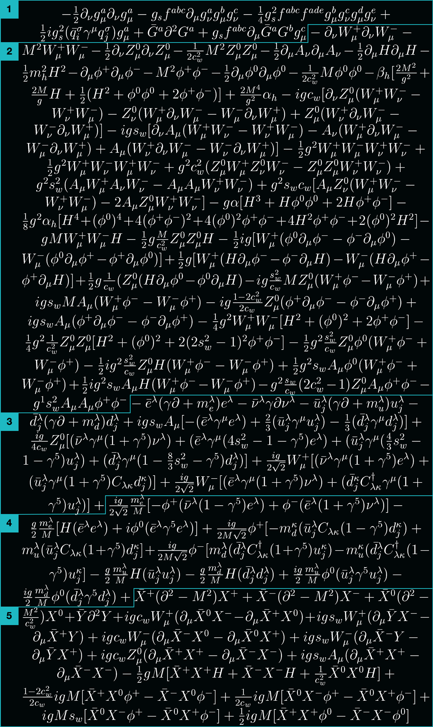



Under the Hood – how ML works
THE STANDARD MODEL
Nature is governed by laws
Humans are sometimes able to discover these
However, it usually takes a lot of effort
More importantly, a lot of time (years/decades)
$$E= mc^{2}$$
Some are concise and elegant
Others are … well …
businessinsider.com

Slide 10







Under the Hood – how ML works
Even ML works by discovering laws
Inspect data and discover laws/patterns that seem to explain data well
$= ≈ + ⇒$ P
FEMALE, 25-30 YRS, HIGH INCOME $⇒$
MALE, 18-25 YRS, MID INCOME $⇒$
$= ≈ + ⇒$ L
MALE, 30-45 YRS, LOW INCOME $⇒$
Remember, this is just an illustrative example. Not all “laws” learnt by ML look like this
ML is able to discover more complex laws more quickly than humans
Indeed! In fact, most patterns and laws learnt by ML are too complex to be interpreted easily

Slide 11
ML and AI
vs

Slide 12
Summary
Machine learning is most suitable to solve tasks where
Humans cannot specify a clear, concise procedure to solve the task
There is too much diversity or variety in the task
There is a need to automate the task given its volume
Machine learning works by analyzing data to identity laws or patterns that seem to explain the data well
The laws learnt by ML may be too complex to be interpreted by humans
Machine learning has seen innovative and impactful applications in several areas but many more are waiting to be discovered
Could be by you!

Slide 13
Stay Awesome!
See you in the next one

